Slide 1
Jane Wilson - Project Manager

Slide 2
The Shifting
Legal Landscape
Legal Aid, Sentencing and Punishment of Offenders Act 2012
Removed Legal Aid for issues about children or finances following separation except where written independent evidence of domestic abuse – from April 2013

Slide 3
An organisation of 6,000 family lawyers and mediators
Committed to a constructive approach to the resolution of family issues and putting the interests of children first
A holistic approach

Slide 4
New ideas including the Parenting after Parting initiative - focused on using soft skills to achieve a positive outcome for children
New developments in the family dispute resolution field – Australian Family Relationship Centres
Complex needs of low income families

Slide 5
Splitting up or getting divorced can be one of the most difficult and stressful events a family can go through. It’s easy to feel swamped or confused about what to do next.

Slide 6
Impact of Separation and Divorce
Children
Immediate Finance
Housing/ Accommodation
Parenting/Sharing care
Debt
Contents
Child Support
financial support/maintenance
Wider family responsibilities
Practicalities
Schools
Benefits
Bank Accounts
Medical Registration
Pensions
Car/s
Insurances
Child Care
Family Documentation
Wills

Slide 7
Impact of Separation and Divorce
Loss
Shock
Anger
Revenge
Denial
Confusion
Isolation
Relief/Guilt
Fear of Hardship
Chaos/Panic
Censure
Individual
Alienation
Disoriented
Sadness
Helpless
Numbness
Illness
(physical/
Mental)
Disbelief
Loss of intimate relationship
Loss of status/face/
Cultural/social identity
Loss of ability to parent effectively

Slide 8
Impact of Separation and Divorce
Housing/ Accommodation
Loss
Children
Confusion
Anger
Sorrow
Residence
Immediate Finance
Contact
Repeated & unresolved mourning
Denial
Confusion
Isolation
Relief/Guilt/ Fear
Anger
Child Support
Relief/Guilt
Contents
Insecurity
Maintenance
Hardship
Chaos/Panic
Censure
Inappropriate ‘parenting’
Individual
Loss of self esteem
Practicalities
Schools
Child
Alienation
Wider family
Disoriented
Sadness
Helpless
Numbness
Bank Accounts
Embarrassment
Shame
Benefits
Medical Registration
Illness
(physical/
Mental)
Disbelief
Pensions
Car/s
Parent not ‘accessible’
Insurances
Loss of Standing/
Cultural Identity
Poor academic performance
Chaos/panic
Loss of ability to parent effectively
Child Care
Shock
Mistrust
Family Documentation
© angela lake-carroll 2009 all rights reserved
Wills

Slide 9
Innovation Fund
Help and Support for Separated Families (HSSF)
£10m for innovative interventions – launched November 2012
Aim to minimise the impact of separation on children by making it the norm for families to seek and understand the support options available to them

Slide 10
Family Matters Guides - trained lawyers and mediators

Slide 11
Family Matters Guides are :
Conveners and engagers
Case managers
Action planners
Supporters and signposters
‘third eye’ for clients

Slide 12
Funded by the HSSF Innovation Fund
Run by Resolution in Oxford,
Newcastle upon Tyne and Crewe

Slide 13
A free service provided at least one parent received a state benefit OR earning an income equivalent to, or less than, the UK living wage.

Slide 14
One parent can use the service even the other doesn’t want to

Slide 15
Family Matters Guides can help parents get the support and information they need, so they can do what’s best for them and their family

Slide 16
A Family Matters Guide will meet parents to discuss the things they’re worried about or questions they need answers to
What's involved

Slide 17
Action plan
Work with each parent to develop an action plan that addresses these issues
First meeting usually for one and a half hours

Slide 18
Sign-posting and information provision
Likely areas of information required by clients:
mediation process
effect separation for children
personal security/protection from abuse
personal support
debt and finances
welfare benefits
legal advice

Slide 19
Building professional networks
Social Services
Benefits agency
Family Matters Guide
GP
Debt adviser
Housing
Counsellor

Slide 20
Action plan
Further meetings to discuss progress and
where they still want help

Slide 21
The Family Matters Guide can meet with both parents together to help them sort out their issues. If mediation would help the Family Matters Guide can refer the couple to mediation
Joint meetings

Slide 22
Jane Wilson - Project Manager

Slide 23
Action plan
What do you need help with?
what it is you would like help with
what you think might help you most, and
what you would like to get out of working with a Family Matters Guide

Slide 24
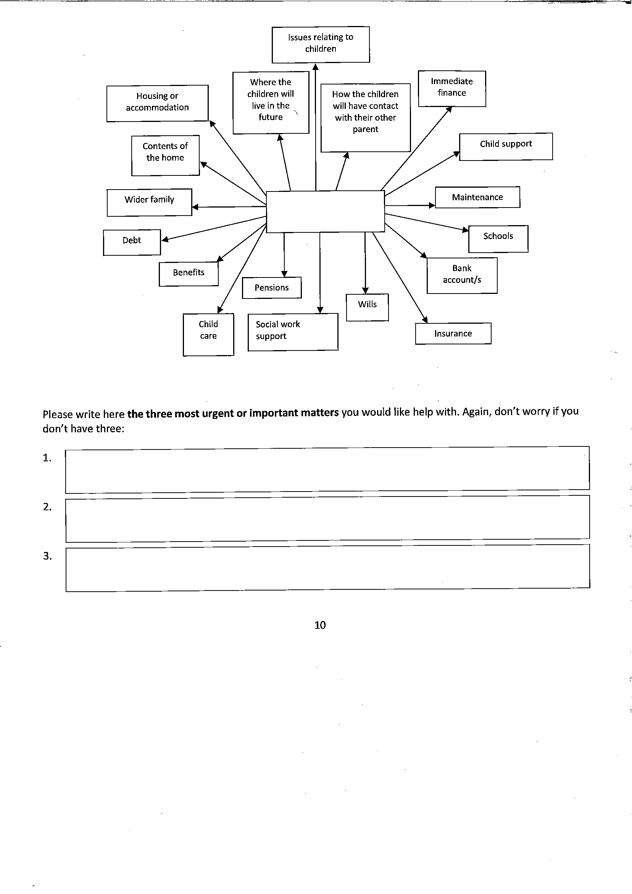

Slide 25
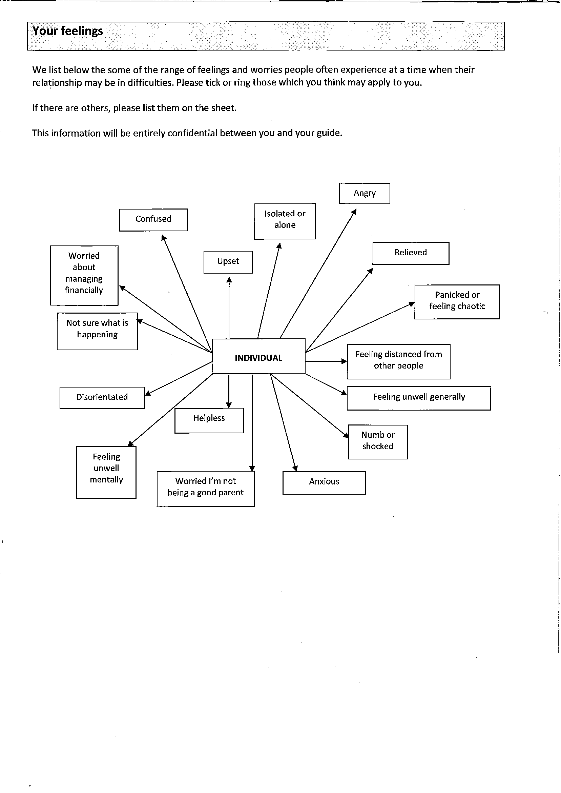

Slide 26
Action plan
Actions for you and for your Family Matters Guide
Goal
What needs to be done
Who needs to be contacted
Who will do it – you or your Guide?
By when Tick when complete

